Slide 1
Online Pizza Ordering System

Slide 2
Team Members
S.No | Name | EMPLOYEE ID
1. | Abhishek Gowlikar | 40124810
2. | Jashwanth Gowda BS | 40121701
3. | Dumbala Soumya | 40121289
4. | Ashwin Dwivedi | 40118758
5. | Twinkal Verma | 40121685
6. | Ashwini Gaikwad | 40121552
7. | Rajkumar E | 40121030
8. | Somnath Mondal | 40122010
9. | Potharaju Raghupathi | 40124791
10. | Syed Mohammed Aijaz | 40124278

Slide 3
Abstract
The Online Pizza Ordering System is the application that allows the users to shop online without going to the shops to buy pizza.

Slide 4
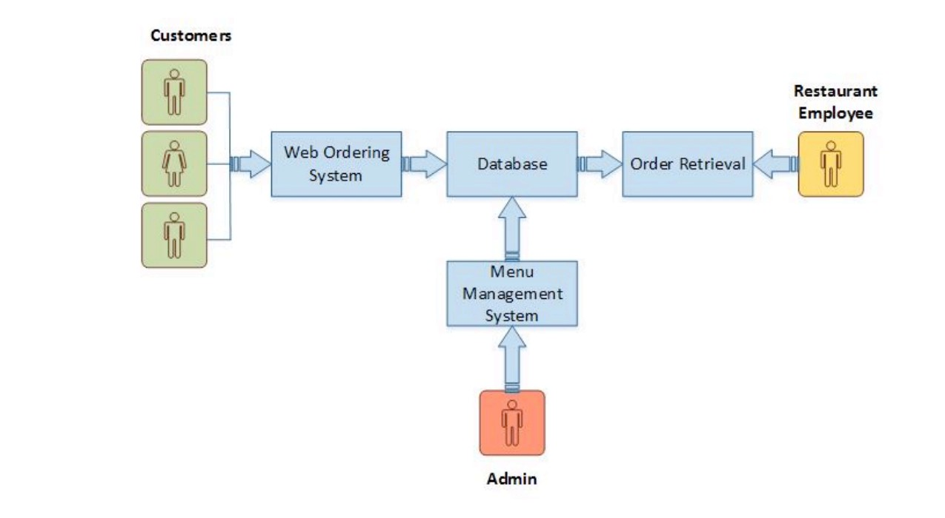
System Model

Slide 5
Login/SignUp
When a customer visits the online pizza ordering system of any pizzeria, he will be asked to log in or sign up for them for a better experience. The customer has to create a unique username and a password. Then he /she need to enter details like Name, phone number,security question. After these steps account of that customer will be created.

Slide 6
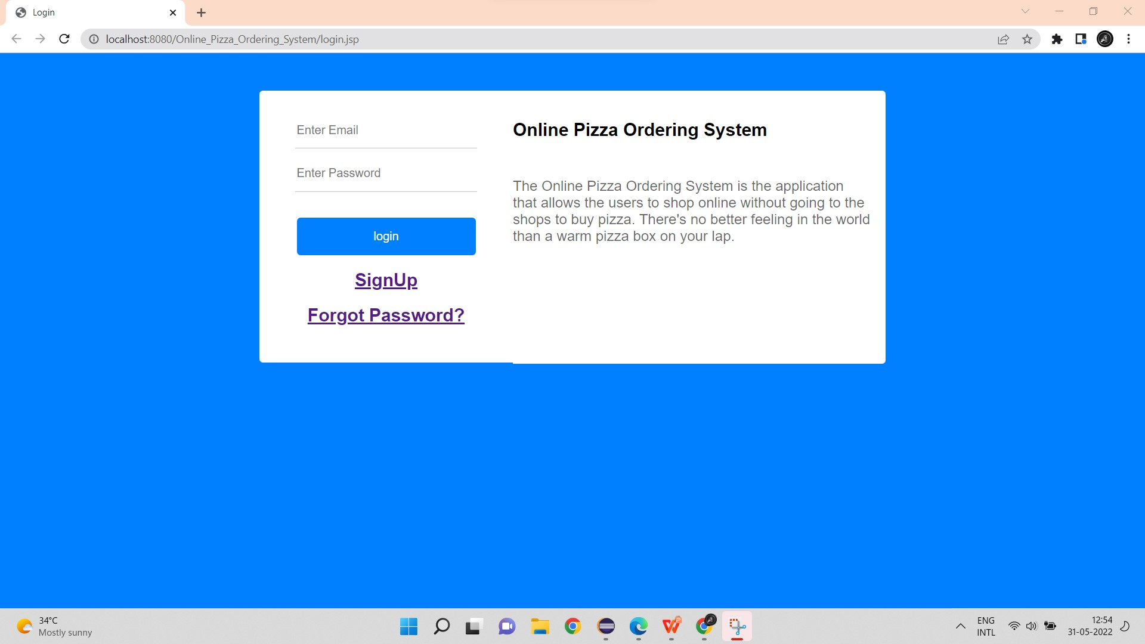
Login

Slide 7
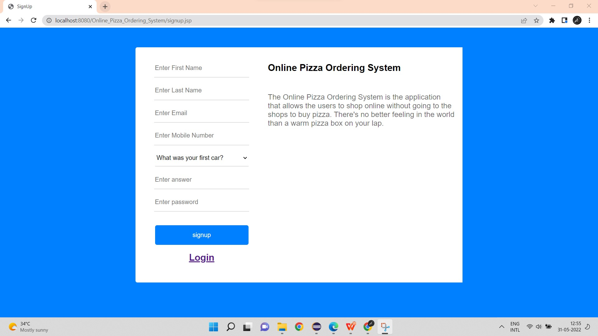
SignUp

Slide 8
Menu
The system will provide customers a menu in which all the pizzas
Each pizza will be shown with its image and price. The ingredients used in the making of that pizza can also be seen.
After each selection or de-selection, the grand total of the order will be updated.

Slide 9
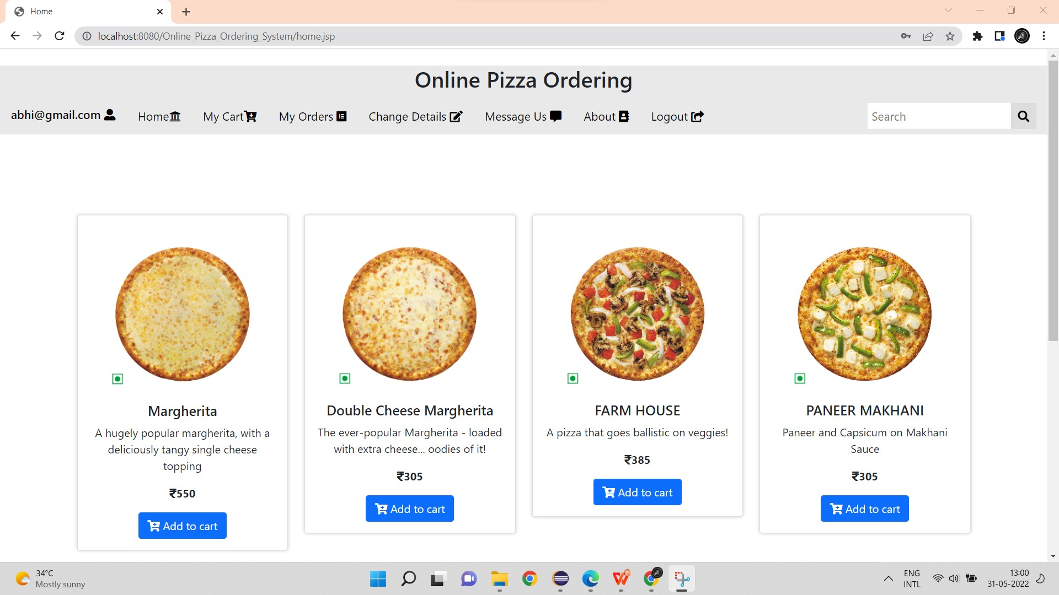

Slide 10
Add To Cart
This feature is useful in a situation where you have to order more than one pizza Suppose you have selected a Margherita pizza and now you want to select another pizza as well. Then you just have to add that pizza to the cart using the Add to cart option. Items added to the cart will be saved so that you can choose other pizzas as well.

Slide 11
Finally, when you are ready to order you can check out from the cart to make payment. Payment There will be basically 2 payment options i.e. online payment using Credit/Debit cards and Internet banking or Cash on delivery. Before making payment, your order details are shown and confirmed. This system makes transactions easier as the need to pay with cash is not there.

Slide 12
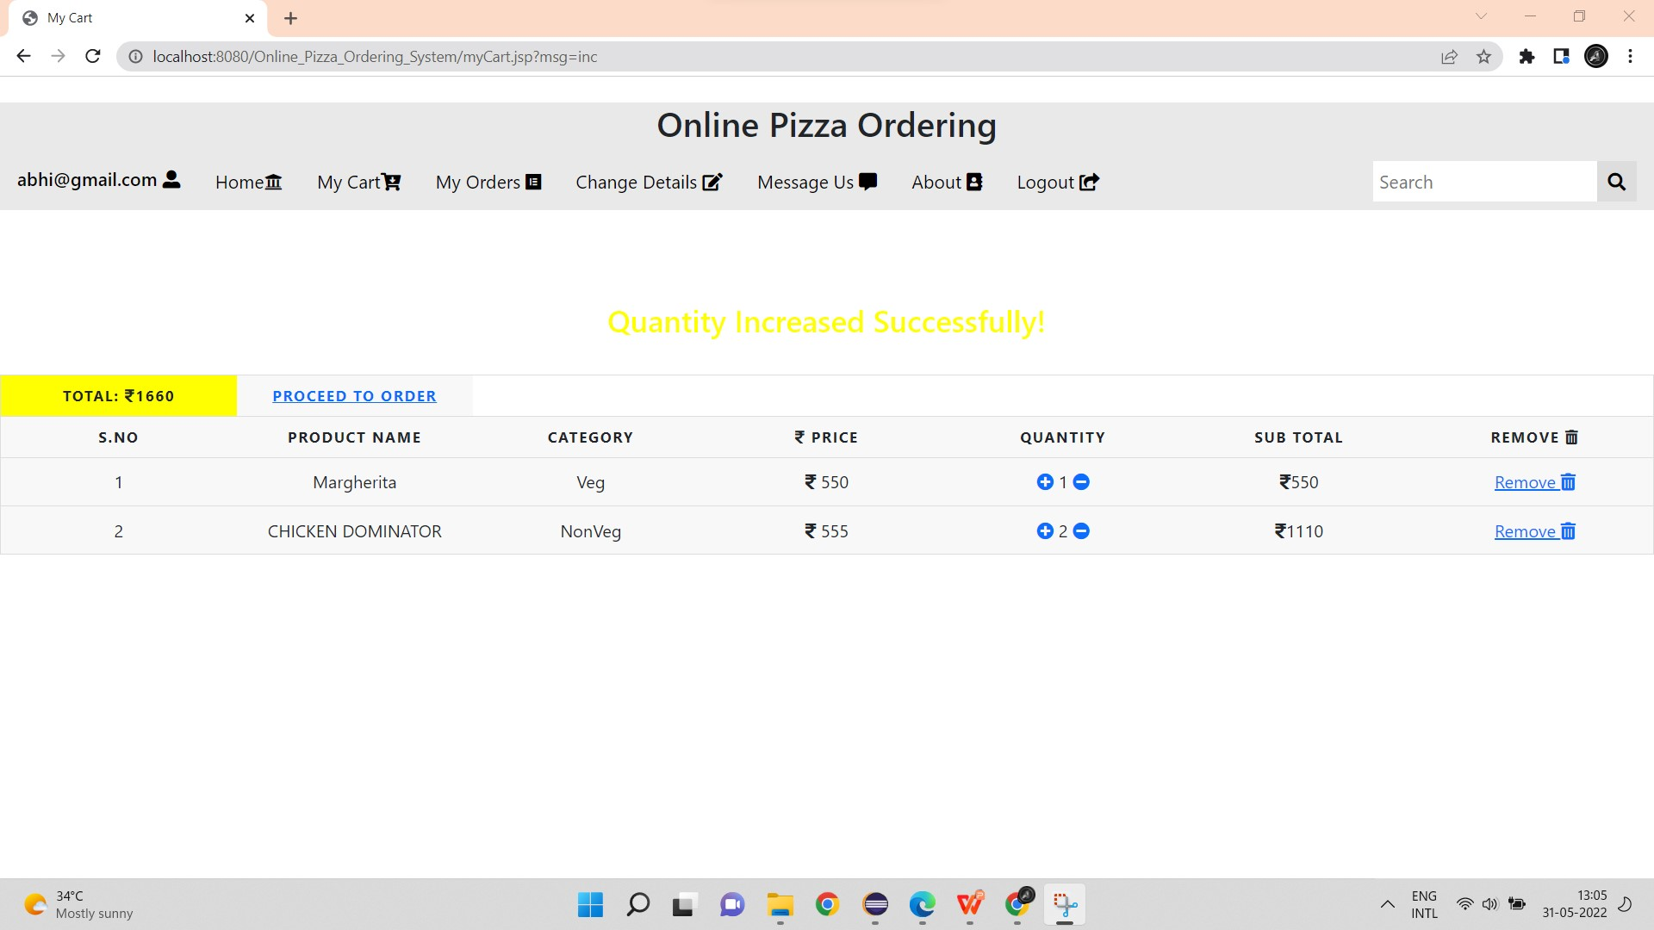

Slide 13
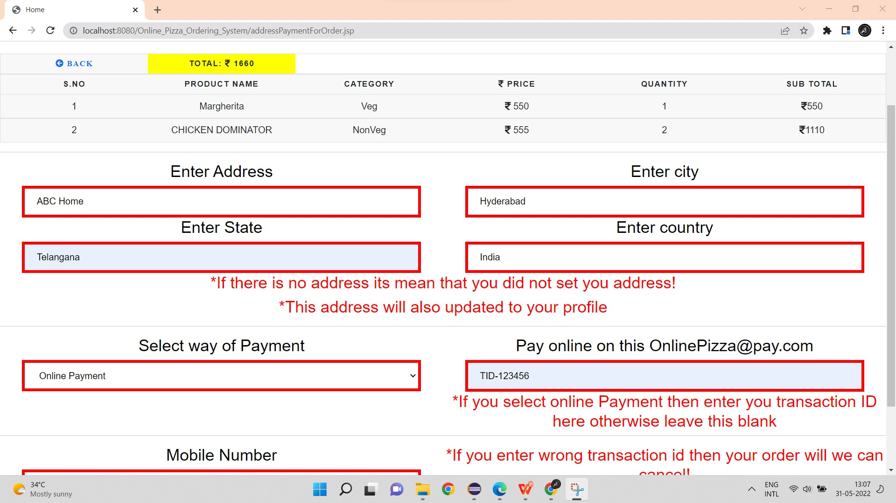
Proceed To Order

Slide 14
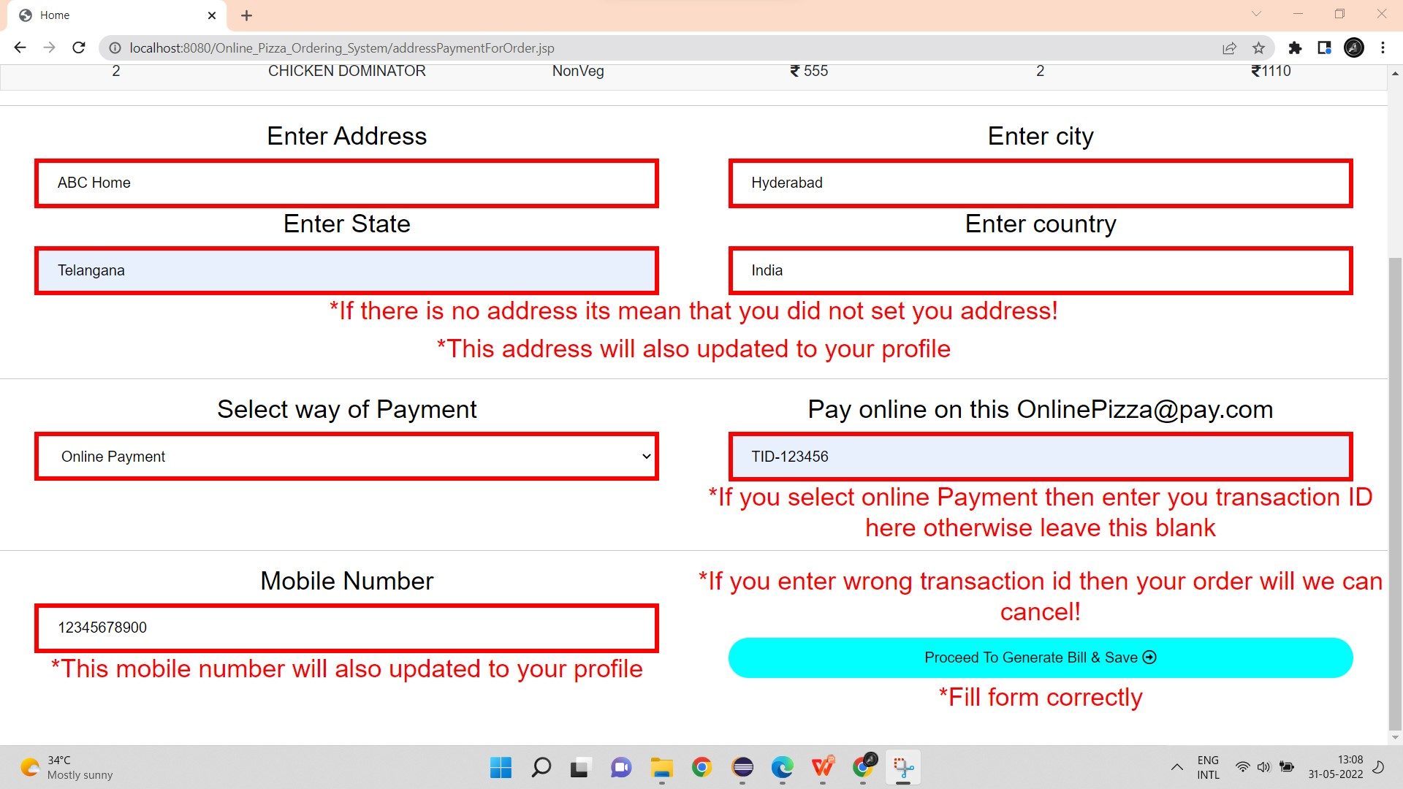
Proceed To Generate Bill

Slide 15
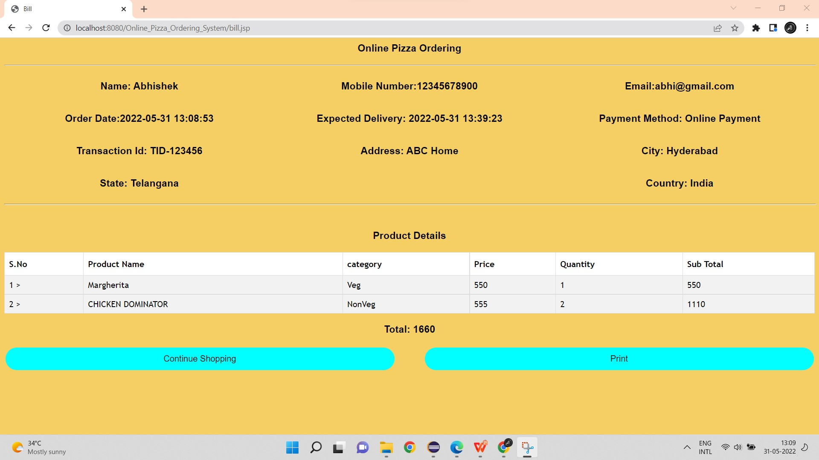
Bill Details

Slide 16
Administration:
Two most important modules of the online pizza ordering system. Let us move our discussion towards the last (but not the least) module of this system i.e. Administration. The administration module is equally important in the functioning of this system. The user is of this module is known as Admin or superuser.

Slide 17
The tasks which can be performed by the admin are:
Admin can add/edit/delete new pizzas, their images, prices, and other details.
Admin has rights to add/edit/delete orders for customers.

Slide 18
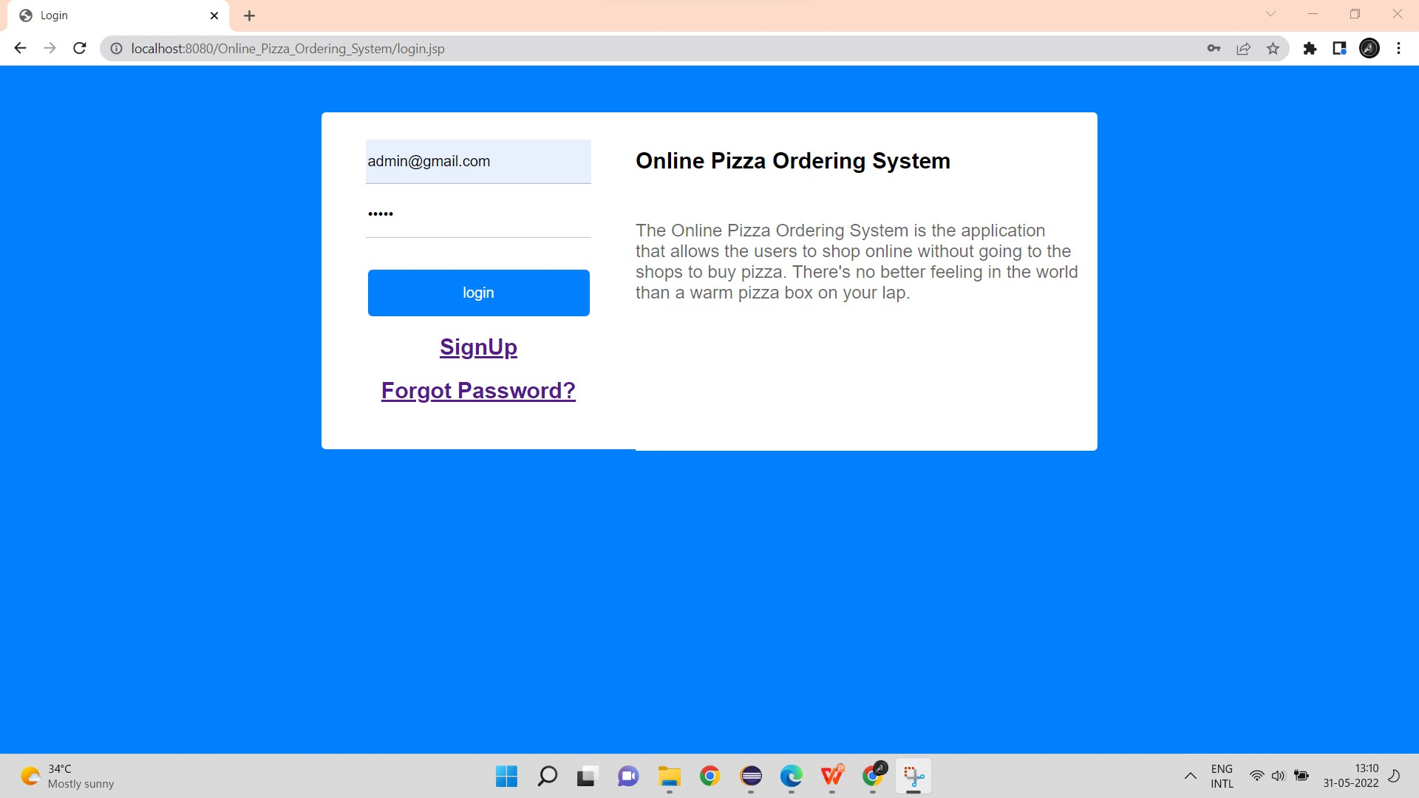
Admin HomePage

Slide 19
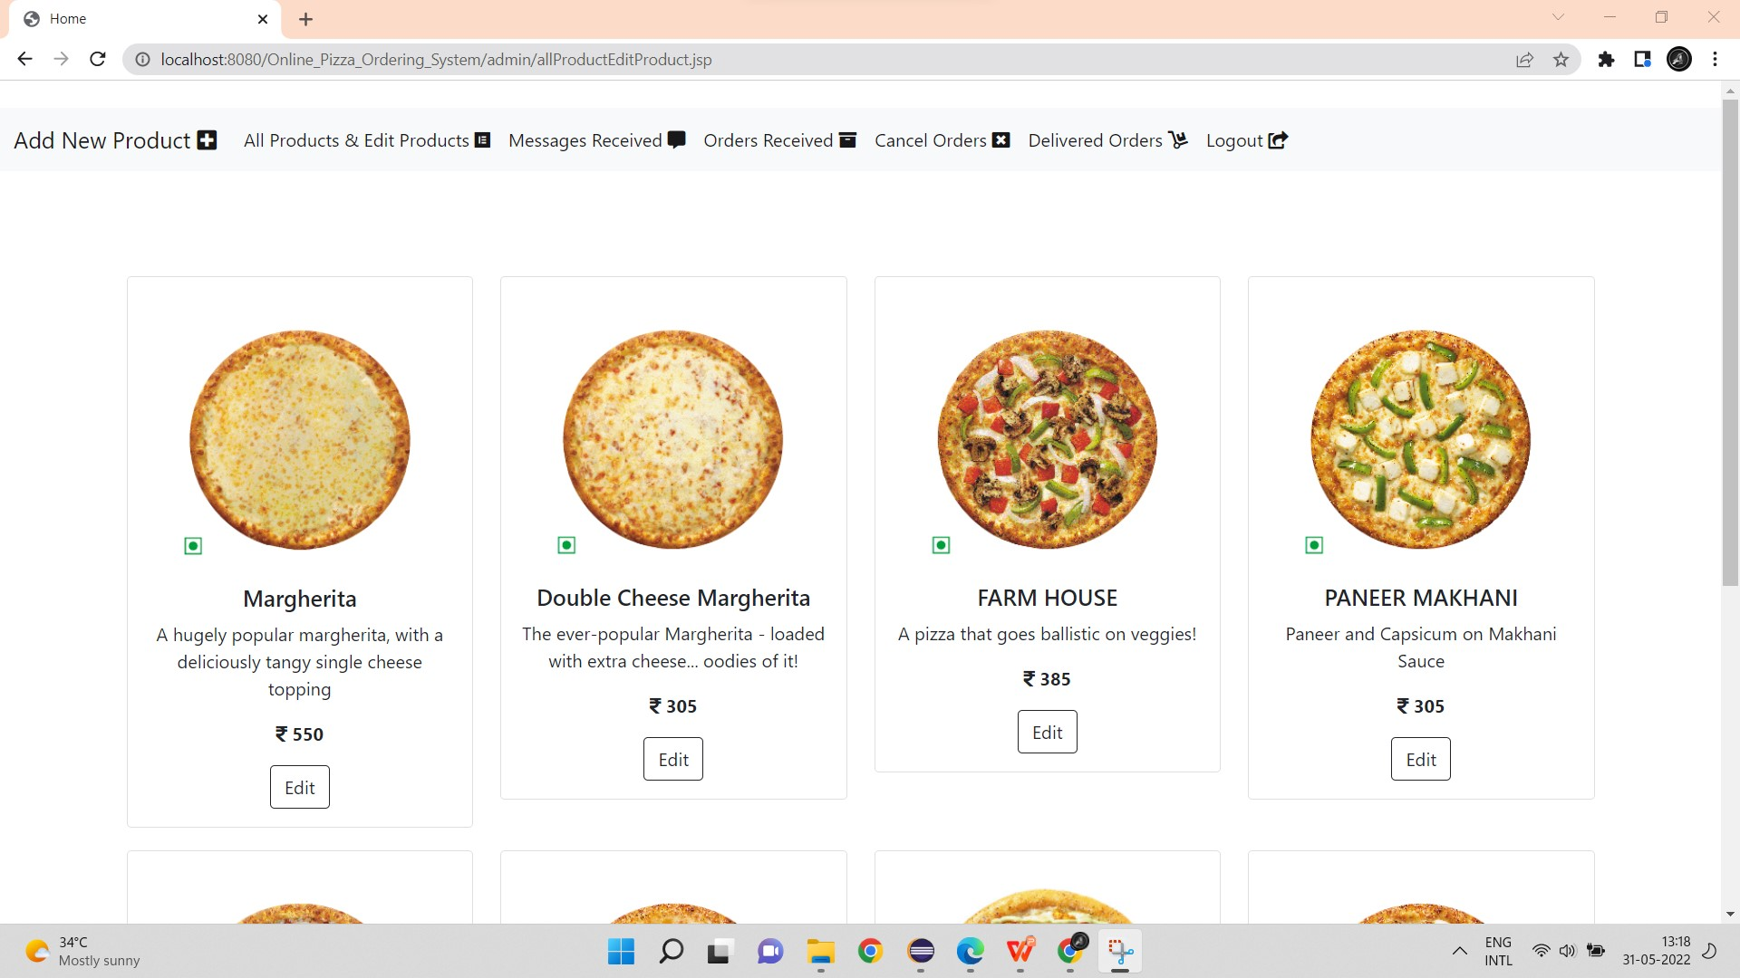
All Products and Edit Product

Slide 20
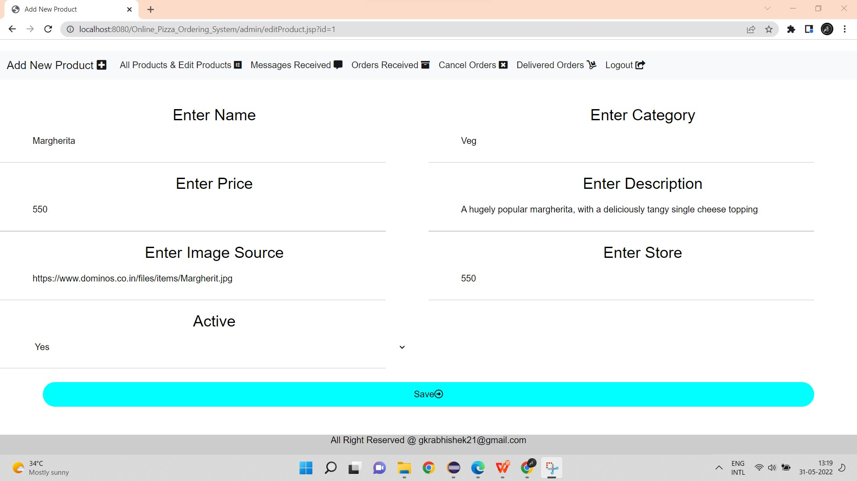
Edit Product/Pizza

Slide 21
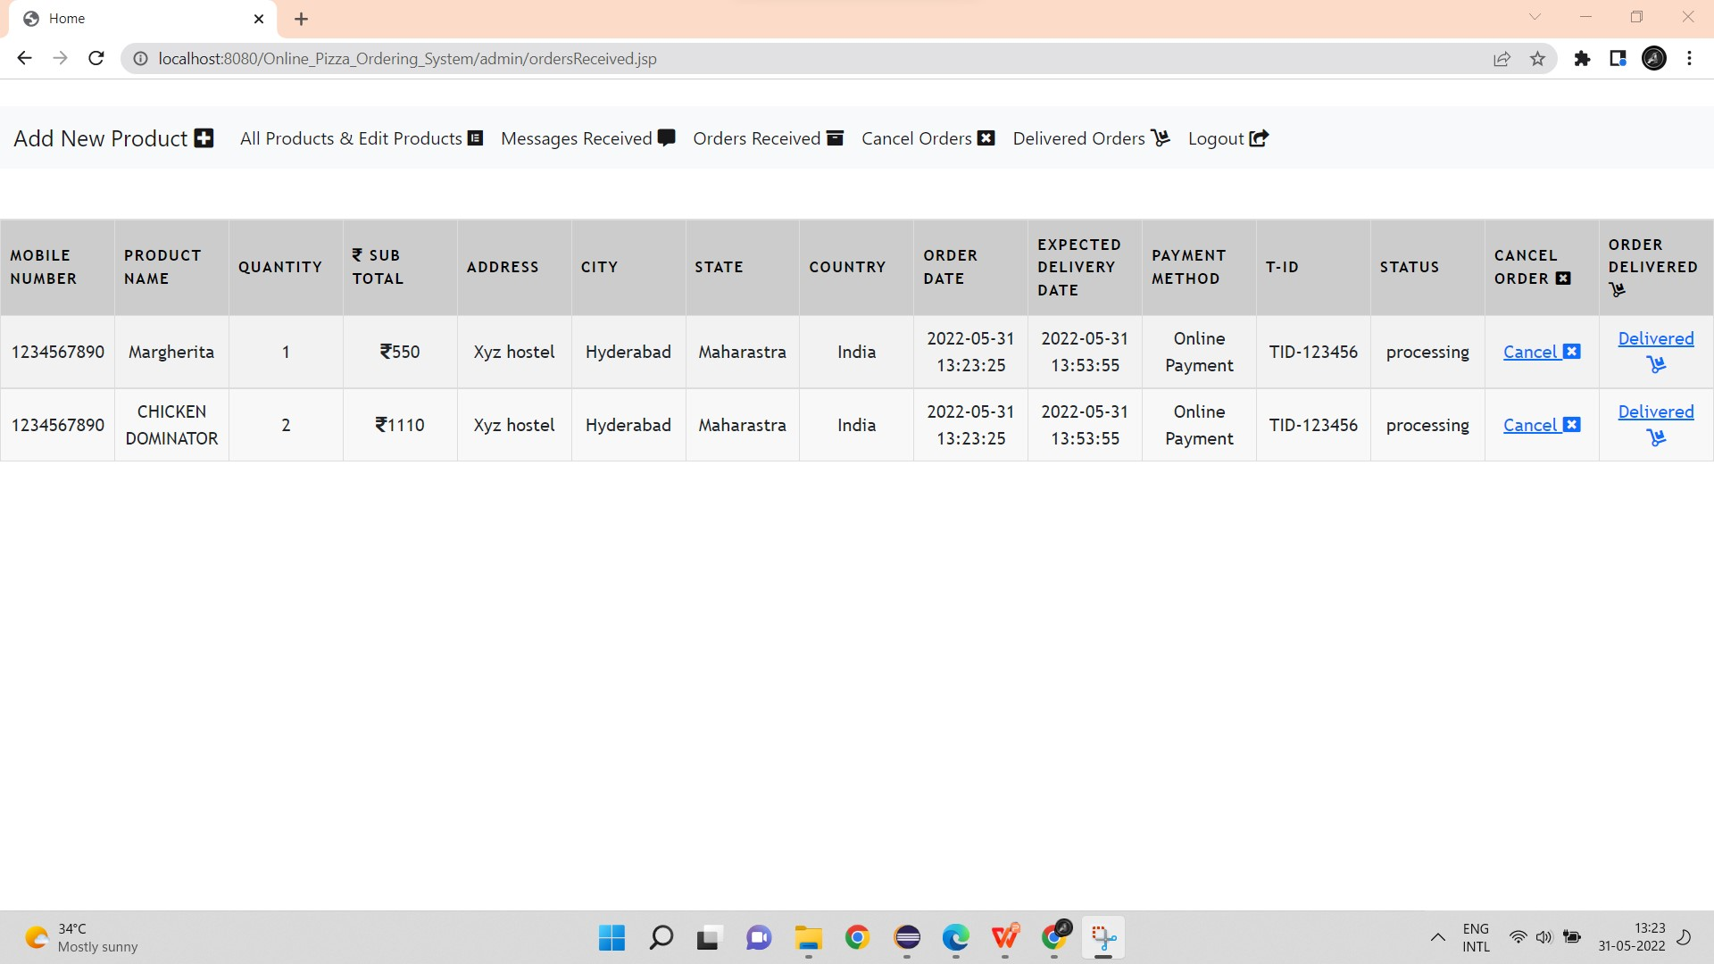
Orders Recived

Slide 22
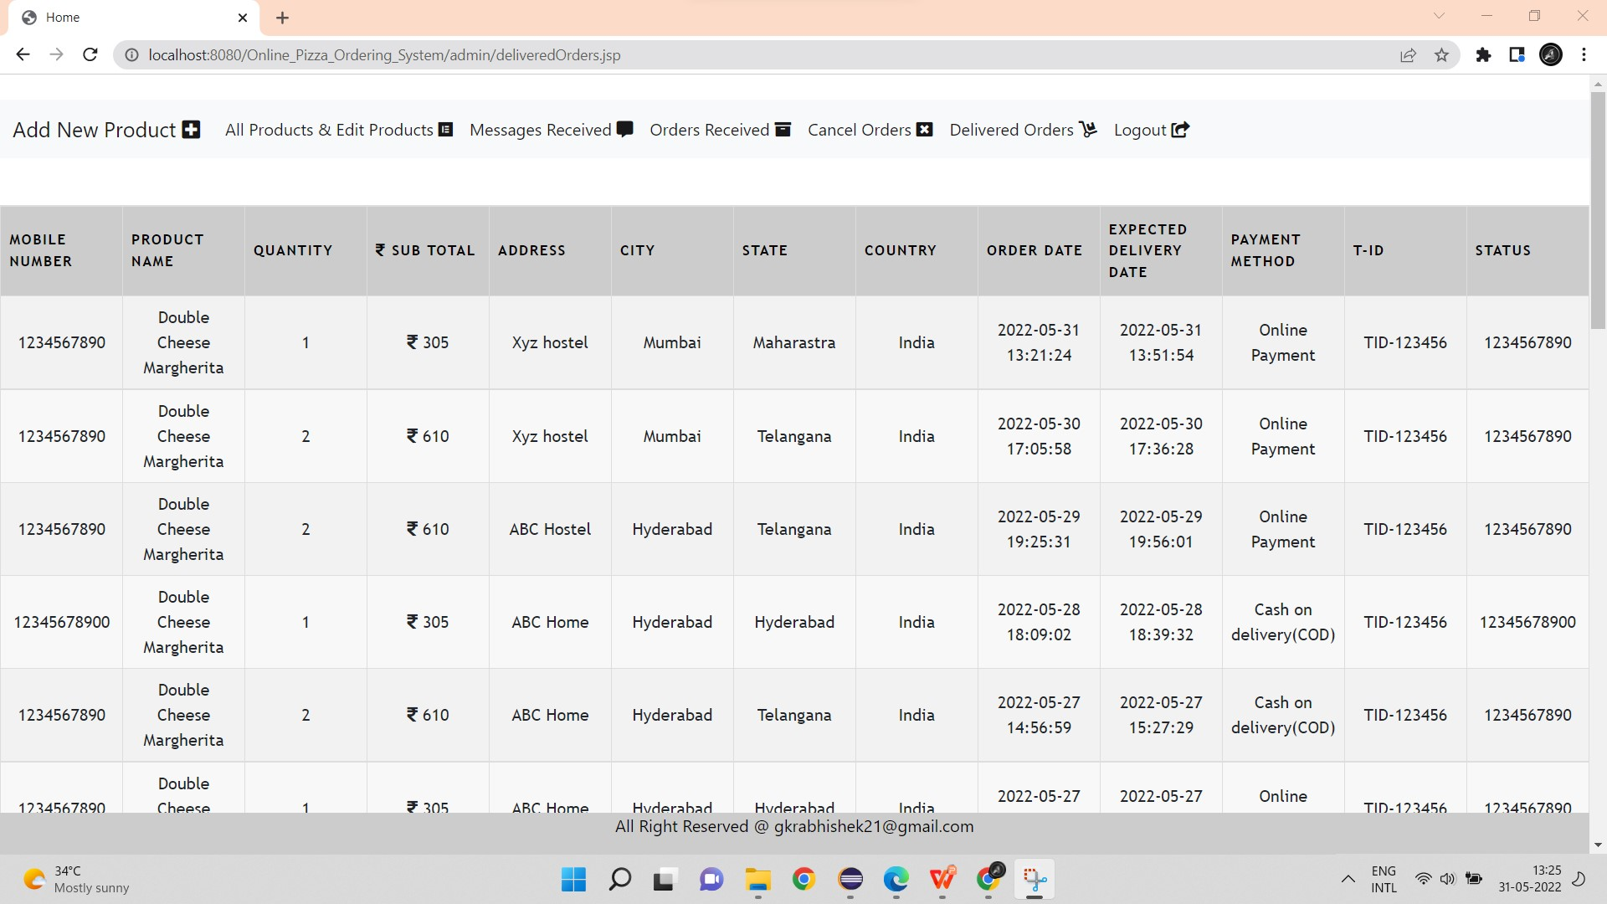
Delivered Orders

Slide 23
Activity Diagram
This section lists the activity diagram and describes the flow of the activities in the system. A detailed description is then given after the figure for each activity. Figure provides the overview of the activity of the Online Pizza Order System application.
All users of the system, are provided with below menu options:Home, My Cart,My Orders,Change Details, Message Us, About and LogOut

Slide 24
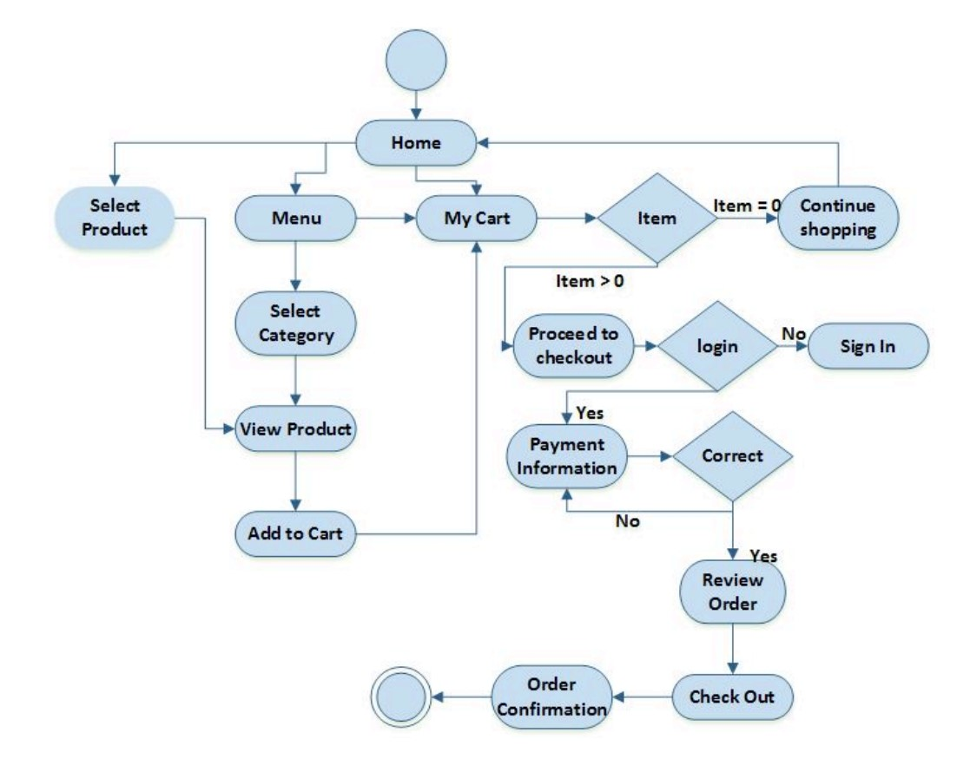
Activity Diagram

Slide 25
Conclusion
This was all about the online pizza ordering system. You know the importance of this system in our day-to-day lives as we all prefer online ordering over-ordering on phone. All these modules can be implemented in the web application.

